Slide 2
The Battle of Neighborhoods

Slide 3
purpose
Help people in exploring better facilities around their neighborhood. It will help people making smart and efficient decision on selecting great neighborhood out of numbers of other neighborhoods in Scarborough, Toranto.

Slide 4
2. Data Section
Data Link: https://en.wikipedia.org/wiki/List_of_postal_codes_of_Canada:_M
Will use Scarborough dataset which we scrapped from wikipedia on Week 3. Dataset consisting of latitude and longitude, zip codes.
Foursquare API Data:
We will need data about different venues in different neighborhoods of that specific borough.

Slide 5
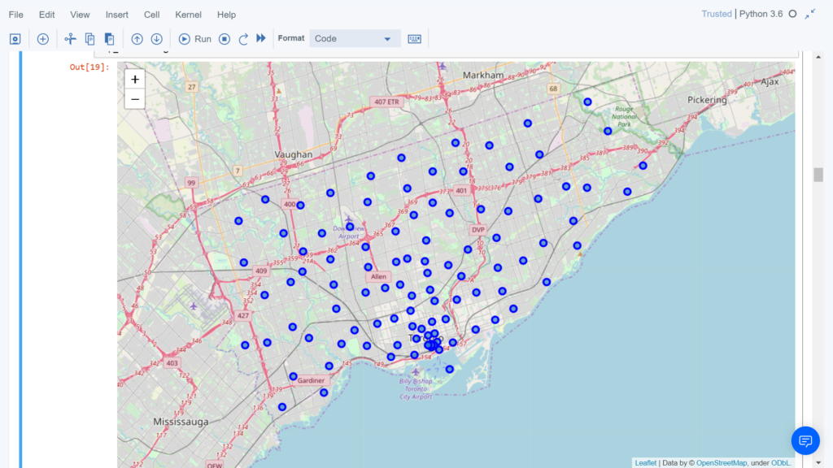
Map of Scarborough

Slide 6
Methodology Section
Clustering Approach:
To compare the similarities of two cities, we decided to explore neighborhoods, segment them, and group them into clusters to find similar neighborhoods in a big city like New York and Toronto. To be able to do that, we need to cluster data which is a form of unsupervised machine learning: k-means clustering algorithm.
Using K-Means Clustering Approach
Most Common Venues near Neighborhood

Slide 7
Results Section
Map of Clusters in Scarborough

Slide 8
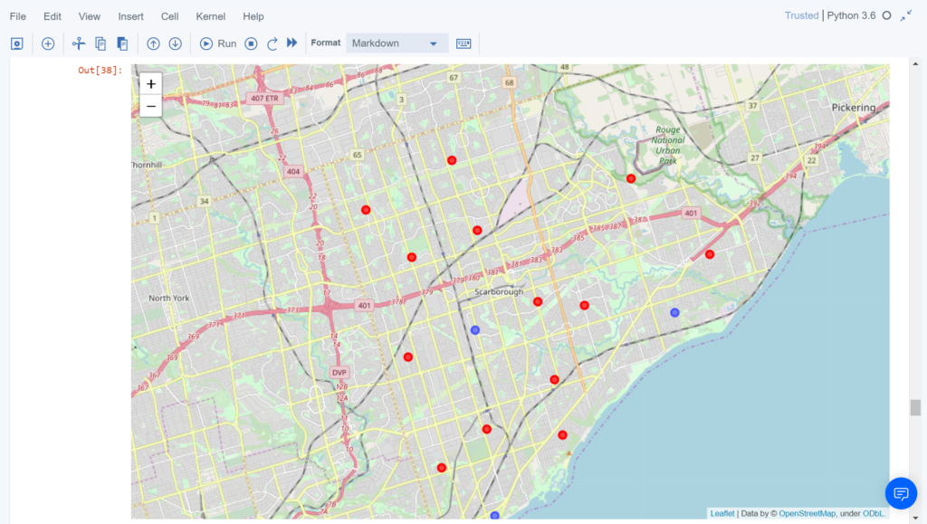
Map of Clusters in Scarborough

Slide 9
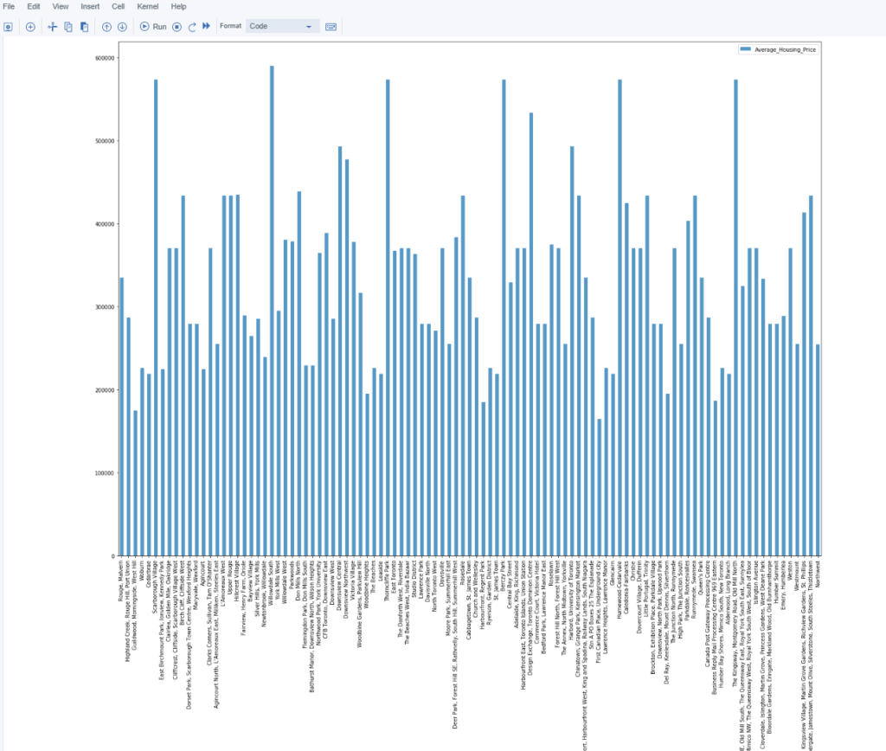
Average Housing Price by Clusters in Scarborough

